Slide 1
To REM & Back
2D Game
Presented By Amin Al-Ait & Adnan Jabbado

Slide 2
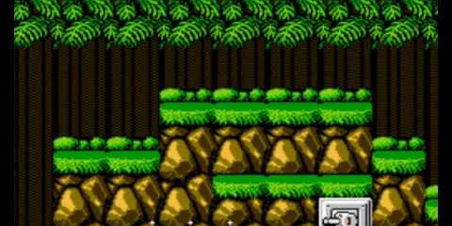
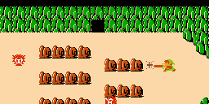
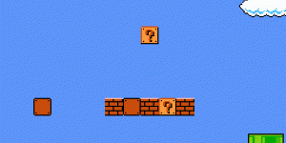
Classic 2D Games
CONTRA
Zelda
Super Mario Bros.

Slide 3
Classic 2D Games
MARKET
VARIETY
TECHNOLOGY
New to the consumers
Companies afraid to try it.
Very small market.
Very few games were made.
All games consisted of the same mechanics.
4 Basic Colors design
Memory and Storage limitations
Poor device/hardware capabilities.

Slide 4
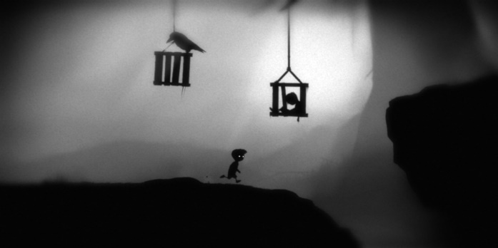
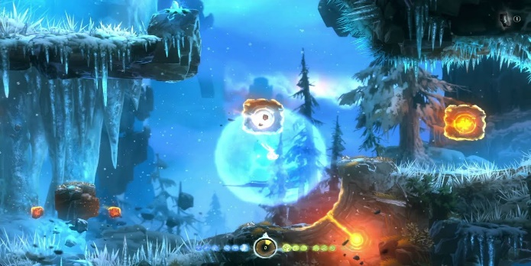
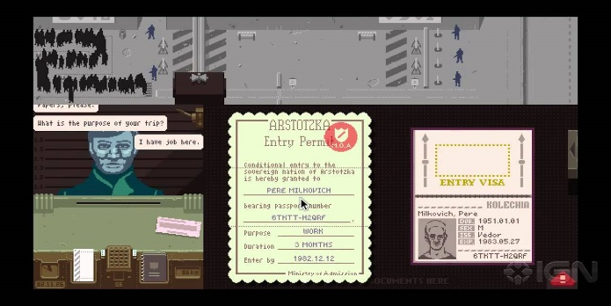
Modern 2D Games
LIMBO
Ori and the Blind Forest
Papers Please

Slide 5
Modern 2D Games
MARKET
VARIETY
TECHNOLOGY
Booming market
Independent/Indie developers are encouraged to create.
Very big market.
Wide and varied set of different genres and stories.
Games are featuring many different mechanics.
Millions of combinations of colors.
Very rare memory and storage limitations.
Innovative and powerful device/hardware capabilities.

Slide 6
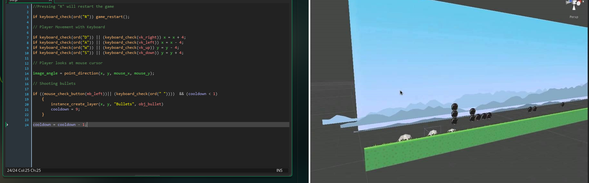
Game Maker Studio (GML Language)
What is Game Maker Studio?
Layers and Z-Axis in 2D Games

Slide 7
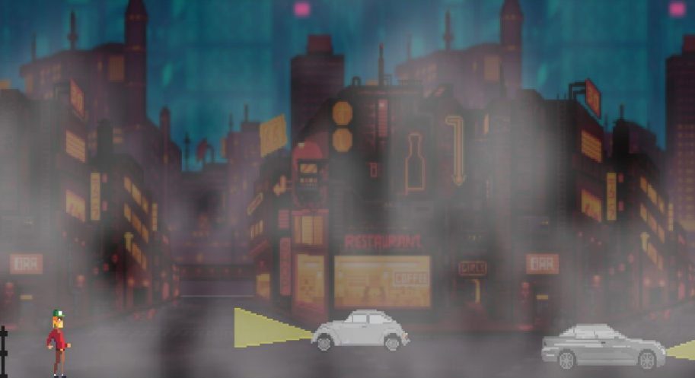
What is “To REM & Back”?
To REM & Back is a 2D game made using Game Maker Studio (GML Language), that features:
Two different camera settings:
Top Down View & Side Scroller View
Story-based puzzle solving gameplay: With Random Level Generation & Enemy A.I Search/Follow system

Slide 8
Motivation behind “To REM & Back”?
We chose to make a game for the senior project out of:
Pure passion for games and game making.
Our desire to tell a story in an interactive, challenging, way.

Slide 9
Development Process

Slide 10
Development Process Layout
Planning
Brain Storming
Script
Dialogues
Links
Execution
Mechanics Design
Level Design
Assets & Character Animation
Scenarios

Slide 11
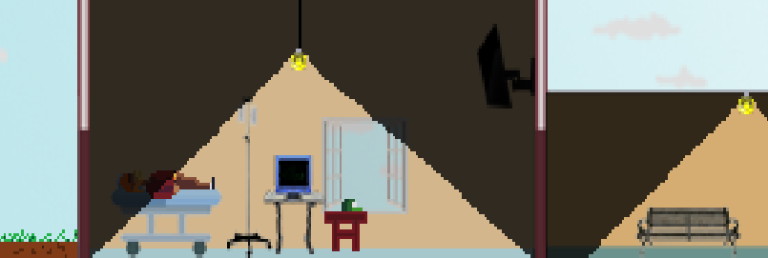
The Story
To REM & Back
Story and narrative (Side Scroller)

Slide 12
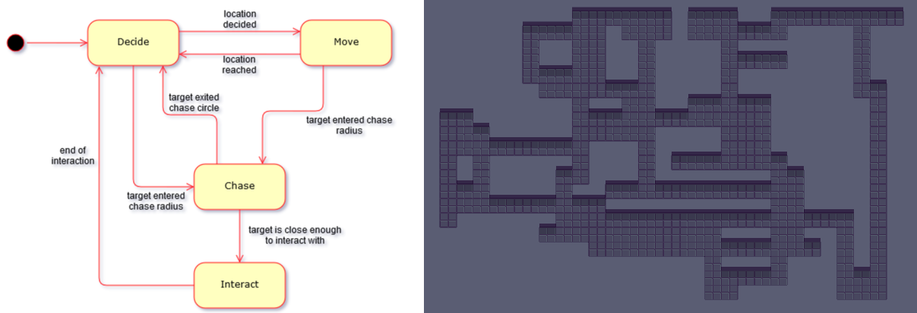
Features & Mechanics
Finite State Machine (Enemy AI)
Random Level Generation

Slide 13
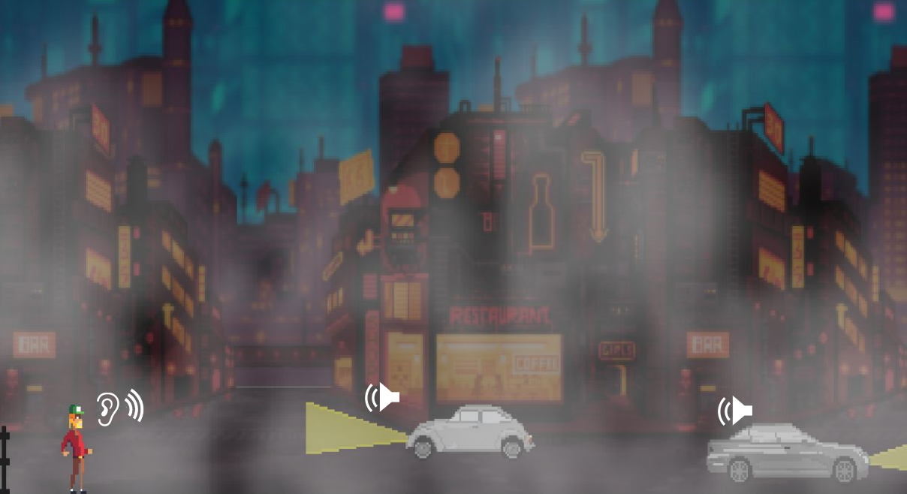
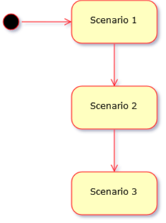
Features & Mechanics
3D Audio Programming
Scenarios

Slide 14
Future Plans

Slide 15
Future Plans
Finished Product
Release in the Market
Commitment
To finish the game as a whole with all of its story branching and puzzles and original assets.
Once the game is finished, it will be released on stores and platforms for PC (Steam, etc…)
As is the case with any product, we have to keep it up to date and running for the clients to enjoy it.

Slide 16
THANK YOU FOR YOUR TIME

